Slide 1

Lucky Retriever Contacts
COP 4331 Spring 2026
Dr. Yadavally
Small Project – Group 7
February 27, 2026 (12:30 – 12:42)

Slide 2
COP 4331 - Small Project - Group 7
Group Introduction
  Phillip Lintereur (Front-End / PM)
  Andrew Kelton (Front-End)
  Ernesto Lugo (API)
  John-Clement Gallo (API)
  Leandro Vivares (Database / API)
Small Project Domain Name
  http://cop4331-pal.com
GitHub Repository
  https://github.com/AndrewKelton/Small-Project

Slide 3
COP 4331 - Small Project - Group 7
Project Requirements
  Web App that serves as a Contacts Management System
  LAMP Stack
    Hosted on Digital Ocean Droplet
  Functionality
    Login/Register
    CRUD Operations - Create, Read, Update, Delete
    Search Function (Partial Match)
  Contact Information
    First Name, Last Name, Email, Phone Number, Date Contact was Added
  Use API’s for communication between client and remote server
  Request/Response Packages using JSON

Slide 4
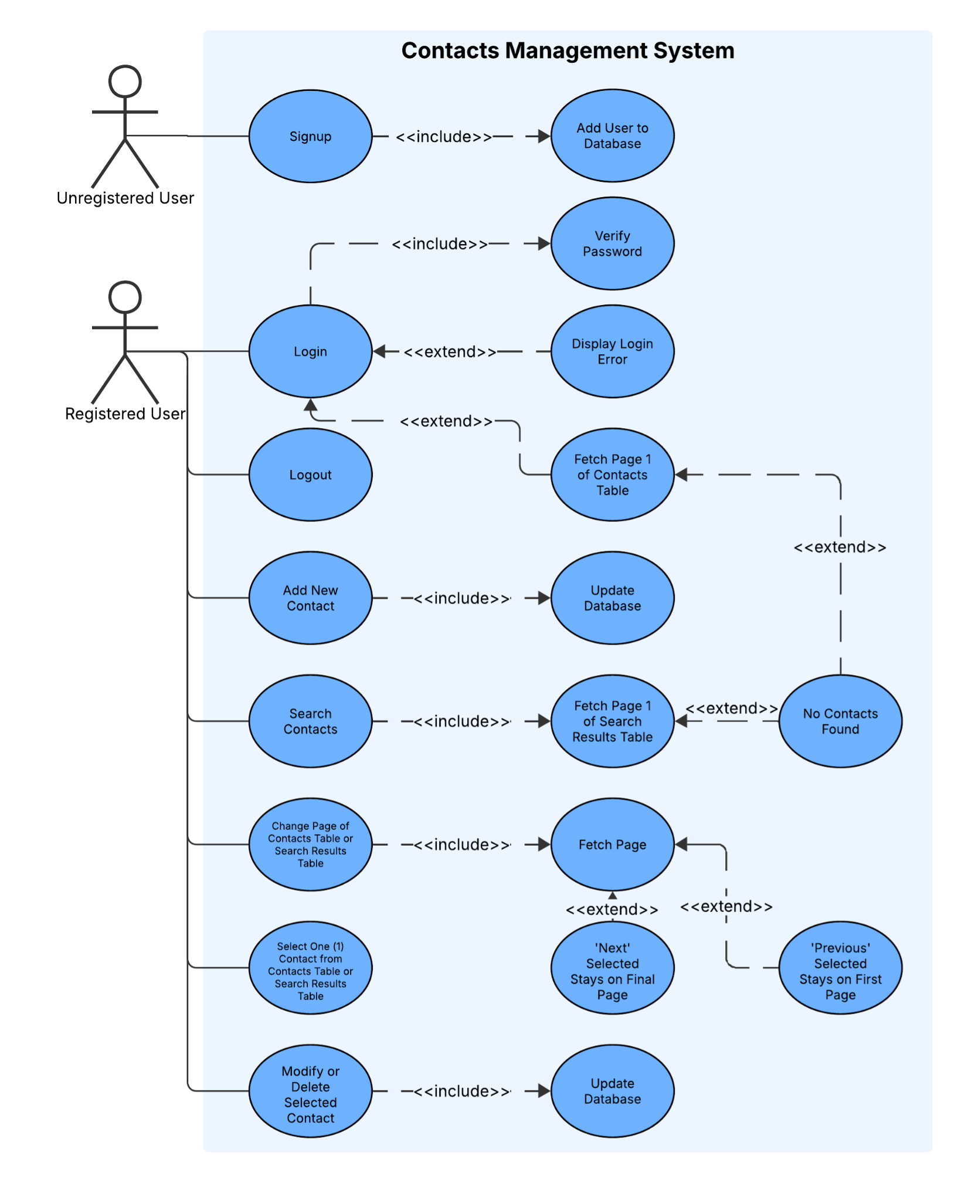
COP 4331 - Small Project - Group 7
Use-Case Diagram
  System
    Web-App (Contacts Management System)
  Actors
    Unregistered User
    Registered User
  Use-Cases
    What functions does the system provide?

Slide 5
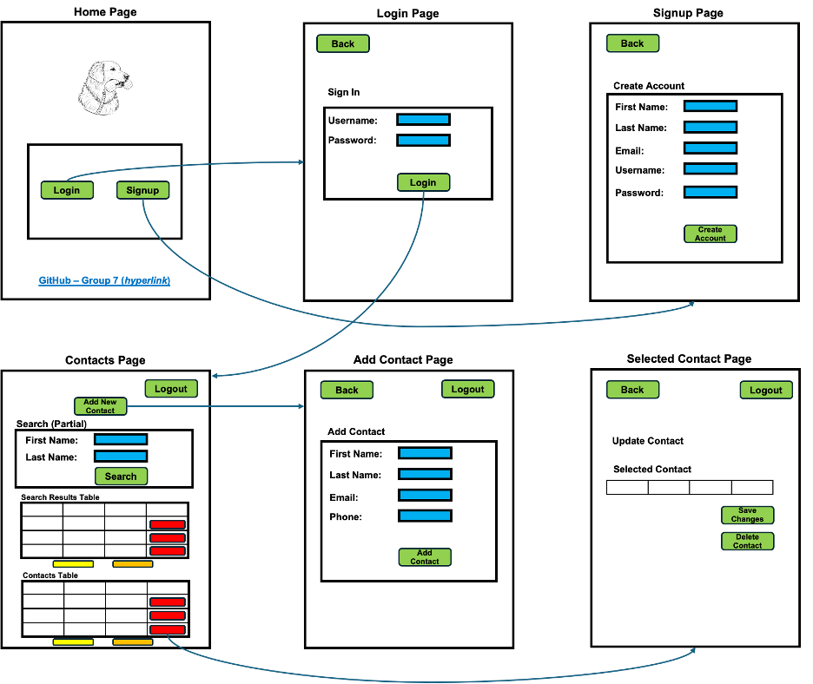
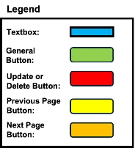
COP 4331 - Small Project - Group 7
Web App Layout
  System Design
    Wireframe
    Functional Specifications

Slide 6
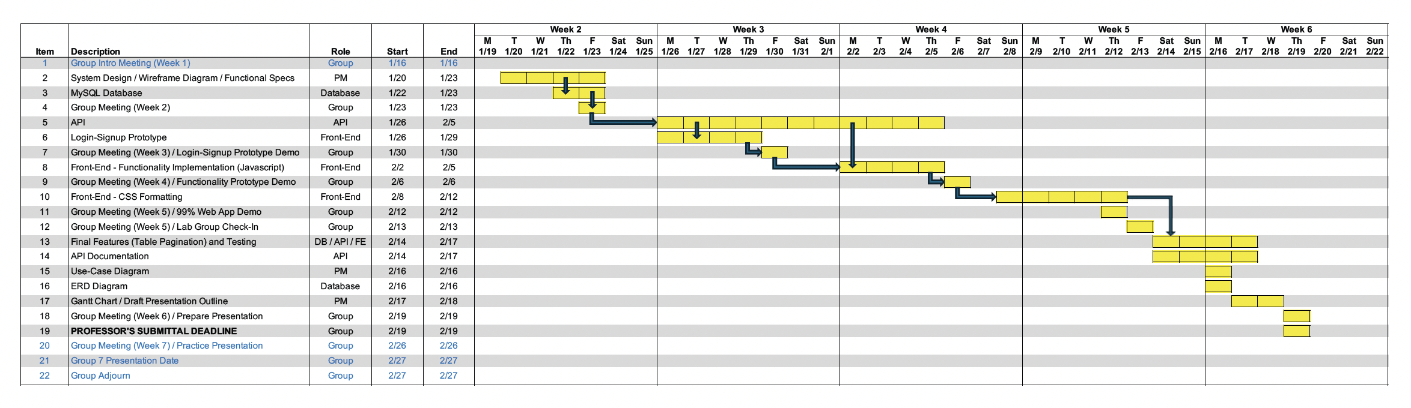
COP 4331 - Small Project - Group 7
Gantt Chart
  Group Coordination – Weekly Meeting and Discord
  Program Progress and GitHub Protocol

Slide 7
COP 4331 - Small Project - Group 7
Things that went well
  Overlapping of workflow and prototyping sped up production.
  Got into a rhythm after getting a few key features implemented on the front-end.
  Generally met key deadlines towards the end of the project
    Functionality Prototype
    Final CSS Formatting by Lab Group Check-In
Things that could have gone better
  git took time to adjust to, which slowed testing of features.
  Missing a critical requirement (limit on loading contact table) late in the project.
    Challenge with table paging edge-case
  CSS formatting for mobile device.

Slide 8
COP 4331 - Small Project - Group 7
Database Overview
  Database Description
    Uses a MySQL database, which uses a query language that prioritizes relationships between tables and information
  Design Decisions
    Enforced unique constraint on unique fields, i.e. usernames
    Uses foreign keys to reference owners of contacts
    Cascading deletes upon removal of user

Slide 9
COP 4331 - Small Project - Group 7
Database Overview
  MySQL
    A relational database management system for SQL databases
    Abstracts the storing and managing of data
    Primarily interactable via CLI in the droplet
    Compatible with MySQL Workbench to manage the database with a GUI
  Entity Relationship Diagram (ERD)
    A useful tool for visualizing relationships between entities in a database.
    Outlines primary keys, foreign keys, data types, and entity counts.

Slide 10
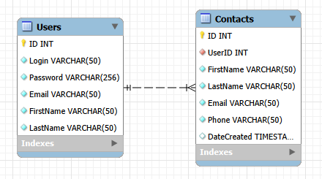
COP 4331 - Small Project - Group 7
Entity Relationship Diagram (ERD)

Slide 11
COP 4331 - Small Project - Group 7
Database AI Disclosure
  ChatGPT-5.2:
    Used to get a basic grasp on SQL and simple query statements and verifying safety and security of statements
    Generated 100 test entries for contacts table for demonstration and pagination testing
    Sanity-checked for editing deployed database tables to preserve data
    Error code translation and general debugging.

Slide 12
COP 4331 - Small Project - Group 7
API
  API Overview
    REST API
    JSON Client-Server Communication
    PHP
    SwaggerHub
    Postman
    AI Disclosure

Slide 13
COP 4331 - Small Project - Group 7
API
  Authentication APIs
    Login
      Checks for an existing user in database matching credentials, and returns the user's ID, first name, and last name
    Sign-up
      Ensures no user exists with the same username, then creates one using the provided info.

Slide 14
COP 4331 - Small Project - Group 7
API
  Contact APIs
    Add
      Validates and inserts the provided contact info into the database
    Search
      Searches using the first and/or last name provided, and displays contacts in order of best match
    Update
      Changes a contact to match new contact info
    See
      Displays all contacts with respect to the page number

Slide 15
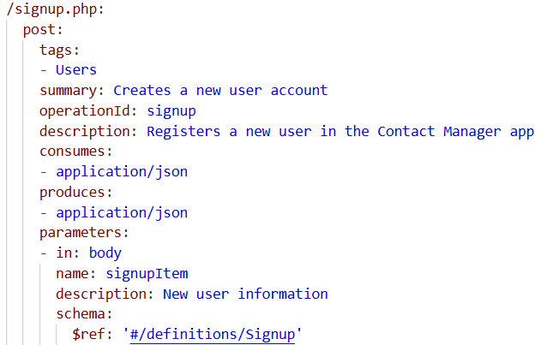
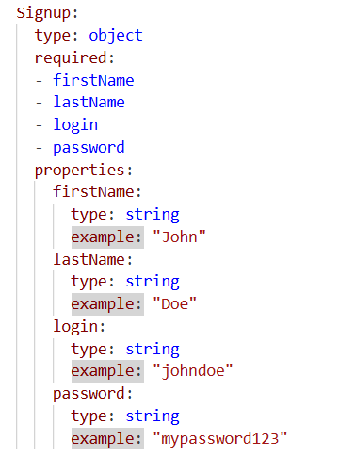
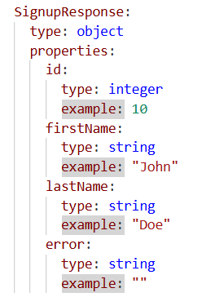
COP 4331 - Small Project - Group 7
Creates new user accounts with validation and duplicate detection
API
  Documentation
  e.g. signup.php
HTTP Status Codes Demonstrated:
200
400
409
Success
User Created
Validation Error
Missing/Invalid Fields
Conflict
Username Exists

Slide 16
COP 4331 - Small Project - Group 7
API
  API End-Point Demonstration

Slide 17
COP 4331 - Small Project - Group 7
Front-End
  Vanilla JavaScript
  HTML
  Cookie-based Session Management
  CSS and Bootstrap 5
  AJAX (asynchronous API calls using XMLHttpRequest)
  Local Development (XAMPP for MySQL, PHP built-in server)
  AI Disclosure

Slide 18
COP 4331 - Small Project - Group 7
Front-End
  Web App Demonstration

Slide 19
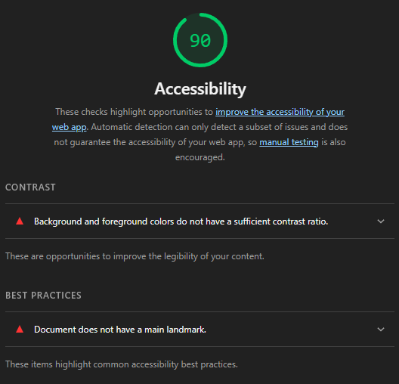
COP 4331 - Small Project - Group 7
Lighthouse Accessibility Report
  Lighthouse is an automated tool for assessing the accessibility of your website
  Grades accessibility via categories like contrast, element placement, keyboard controls, and logical ordering of elements.
  Detected minimal issues, with some outlined warnings being false positives

Slide 20
COP 4331 - Small Project - Group 7
  Questions?

